Slide 1
Colossians 3:15-17
¹⁵ And let the peace of God rule in your hearts, to which also you were called in one body; and be thankful. ¹⁶ Let the word of Christ dwell in you richly in all wisdom, teaching and admonishing one another in psalms and hymns and spiritual songs, singing with grace in your hearts to the Lord. ¹⁷ And whatever you do in word or deed, do all in the name of the Lord Jesus, giving thanks to God the Father through Him.

Slide 2


HOW GOOD IT IS
(D)
HOW GOOD IT IS TO GIVE THANKS
UNTO THE LORD
HOW GOOD IT IS TO GIVE PRAISE UNTO OUR GOD
FOR HE HEALS THE BROKEN-HEARTED
BINDING UP THEIR WOUNDS
IT IS GOOD TO BLESS HIS HOLY NAME
O WE GIVE THANKS UNTO OUR SAVIOR
AND WITH A HEART OF GRATITUDE
WE GIVE HIM PRAISE
HIS MERCIES SHALL ENDURE FOREVER
AND I WILL WORSHIP HIM
ALL OF MY DAYS

Slide 3
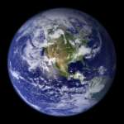
Come, Now is the time to worship (D)
Come, now is the time to worship
Come, now is the time to give your heart
Come, just as you are to worship
Come, just as you are before your God
COME ….
One day every tongue will confess
You are God
One day every knee will bow
Still the greatest treasure remains
For those who gladly choose You now

Slide 4
Jesus we worship you (D-A-Bm-F#m-G)
Jesus we worship you
Like the ancient wise men we come to worship you
Song of praise we sing to you
Gifts of love we bring to you
Jesus O Lord divine we bow before your throne
Hooooo...........

Slide 5
I see You sitting on the throne, O Lord
You are high and lifted up
Above the highest worship I can offer You
I bow myself before Your throne, O Lord
Lifting high up holy hands
For beside You Lord in heaven there’s no other
I cry Holy (MEN) I cry Holy (WOMEN)
I cry Worthy (MEN) I cry Worthy (WOMEN)
I cry Holy (MEN) I cry Holy (WOMEN)
To the Lamb (MEN) To the Lamb (WOMEN)
I cry Holy, Worthy, Holy is the Lamb (ALL)
I cry Holy, Worthy, Holy is the Lamb (ALL)

Slide 6
Various Types of Cell Group
Cell of Self – Centeredness: What’s in this group for me? I don’t want to have serious commitment
Cell for Personal Enrichment: I desire to create a climate where personal growth can take place. Let “peel off layers” to become totally transparent person to each others. We will limit group membership to close friends
Cell for Strengthening The “Witness”: I sincerely desire to witness as a normal lifestyle. We will discuss evangelistic strategy & commit ourselves to fasting & praying
The “Football Team” Cell: I will go to the jails to hold services. We are a group of people who visit home of aged & brighten the lives of those who are shut-in
The “Bible Worm” Cell: I desire to know the truth nothing but the truth
The Cell Church: We desire to produce rapid church growth. Reaching people is not enough, they must become disciples of Jesus Christ and produce fruit that lasts
CPC Cell?

Slide 7
General
  In your opinion, please kindly jot down a list of attribute of a healthy cell
  What are the benefit of attending a cell group?
2. Personal
  What is the expectation and/or value drivers required for you to make it a priority to attend a cell group?
3. Growth
  Kindly jot down a list of supporting activity that might help to promote cell attendance

Slide 8
What do I really want?

Slide 9
Possible Purpose of Cells
To open the doors for people to be saved (Act 10: Peter Meets Cornelius &preach to his household in his home)
To allow people to identify with the leadership (Matt 9:10 – 12: Jesus sat at Matthew’s home with many tax collectors & sinners)
To offer the opportunity to receive a touch from God (Luke 5:19 – 20: Jesus forgive & heals a paralytic man in a home in Galilee)
To Unlock potential through practical training (Ephesians 4:11-16: for the equipping of the saints for the work of ministry)

Slide 10
Challenges
Family Commitment
Social Commitment
Work-Life Balance
My Commitment
Do we still wanted an active Cell Group?
When do we meet & the frequency?
How much time each CM will take?

Slide 11
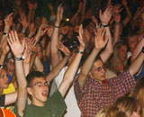
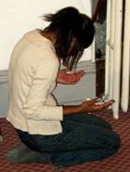
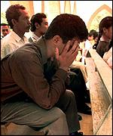
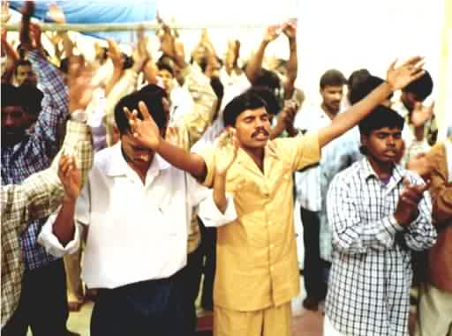
FILL THIS TEMPLE (D)
Let my heart be the
temple of Your Spirit
Let my spirit fill the warmth
of Your embrace
Let me be a holy habitation
Where Your Spirit
is pleased to dwell
O Lord I want to know Your glory
I want to offer the sacrifice of praise
Fill this temple Lord
With Your Spirit once again

Slide 12

FILL MY EYES
Fill my eyes, O my God
With the vision of the Cross
Fill my heart with love for Jesus
The Nazarene
Fill my mouth with Thy praise
Let me sing through endless days
Take my will let my life
Be wholly Thine

Slide 13

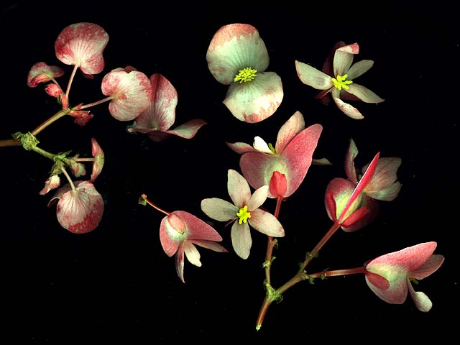
All over the world (D)
The Spirit is moving
All over the world
As the prophet
Said it would be
All over the world
There’s a mighty revelation
Of the Glory of the LORD
As the water cover the sea
All over the church ….
Deep down in my heart ….

Slide 14
I FEEL BETTER
I feel better, so much better,
since I laid my burdens down
I feel better, so much better,
since I laid my burdens down
I feel lighter, so much lighter,
since I laid my burdens down
I feel lighter, so much lighter,
since I laid my burdens down
Thank you Jesus, thank you Jesus,
since I laid my burdens down
Thank you Jesus, thank you Jesus,
since I laid my burdens down

